Slide 1

Application of Lean Six Sigma in Healthy Fast-Food Chain
Nilkamal School of Mathematics, Applied Statistics & Analytics
Semester Ⅵ Project
Quality Management
Mentored by:
Prof. Sunil Shirvaiker
A016 - Kushal Dutia

Slide 2
Literature Review :
Paper Name Author Name Year Methodology
Nilkamal School of Mathematics, Applied Statistics & Analytics
Paper Name | Author Name | Year | Methodology
The Six Sigma Way: How GE, Motorola, and Other Top Companies are Honing Their Performance | Pande, P. S., Neuman, R. P., & Cavanagh, R. R. | 2007 | Methodological framework explaining the DMAIC approach for process improvements.
A framework for effective six sigma implementation. | Jones , Parast and Adams | 2010 | Implementation of Sigma in quality Management Process
The effect of Lean Six Sigma practices on food industry performance: Implications of the Sector's experience and typical characteristics | Costa et al. | 2020 | Mixed-method study using data analytics and case studies of QSRs implementing LSS.
Six Sigma for service processes | Antony, J. | 2006 | Case study-based approach examining LSS implementation in service industries, including QSRs.
Challenges in Implementing Lean Six Sigma in Fast Food Chains | Brown, L., Smith, T., & Wilson, R. | 2019 | Qualitative research identifying barriers to LSS adoption in QSRs.

Slide 3
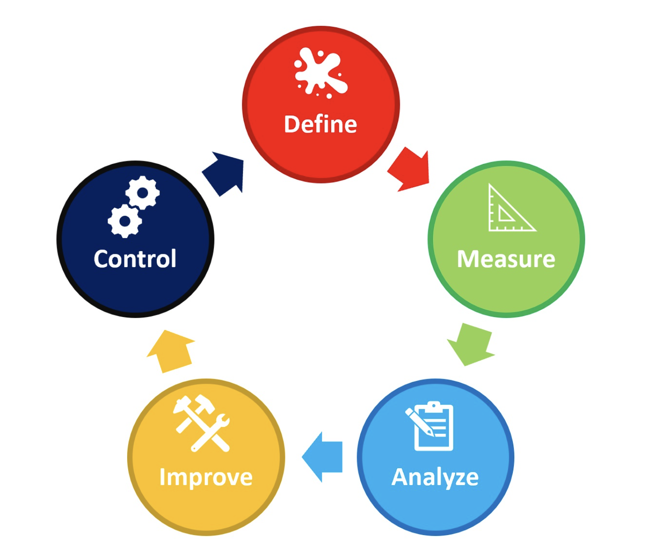
DMAIC
Nilkamal School of Mathematics, Applied Statistics & Analytics

Slide 4
PROBLEM & GOAL STATEMENT
Nilkamal School of Mathematics, Applied Statistics & Analytics
DEFINE PHASE
Problem Statement | Goal Statement
Problem Statement No.1 : Late deliveries increased from 20.1% in 2023-24 to 25.9% in 2024-25(10 months) , resulting in lower customer satisfaction score. | Goal Statement No.1 : Reduce late deliveries from 25.9% to 13% or less by end of Quarter 3 2025 .
Problem Statement No.2 : ​​Complaints on dine – in food quality remain high at 22% in the current financial year. That is 22 in 100 people complain about the quality of food at the store. | Goal Statement No.2 : Reduce complaints from 22% to 11% or less by Quarter 3 2025.
Problem Statement No.3 : ​​Wrong order deliveries doubled from 17% in 2023-24 to 34% in 2024 – 25, increasing rework and dissatisfaction. | Goal Statement No.3 : ​​Cut wrong orders from 34% to 17% or less by Quarter 3 2025.

Slide 5
Project Scope :
Nilkamal School of Mathematics, Applied Statistics & Analytics
In Scope:
Process Improvements – Improving order processing, food preparation, and delivery efficiency.
Food Quality Improvement – Identifying and elimination of food quality issues.
Staff Training – Making kitchen and counter staff more efficient and accurate.
Performance Indicators – Defining KPIs on service time, food quality, and order accuracy.
Customer Feedback Analysis – Collection and actioning of customer feedback.
Out of Scope:
Menu Changes – No deviation from Subway's regular menu
Infrastructure Upgrades – No major store renovation or equipment upgrade.
Third-Party Delivery Logistics – Cannot manage Swiggy/Zomato operations internally.
Corporate Policy Updates – Aligning with Subway's global standards.

Slide 6
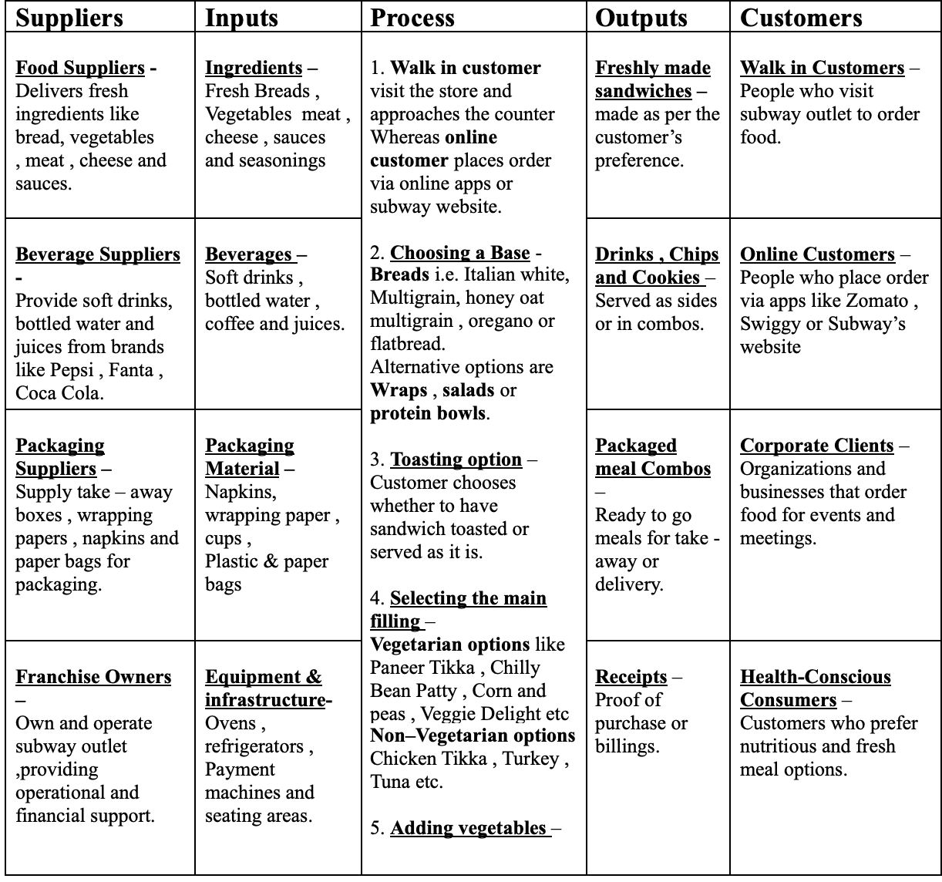
SIPOC Diagram :
Nilkamal School of Mathematics, Applied Statistics & Analytics

Slide 7
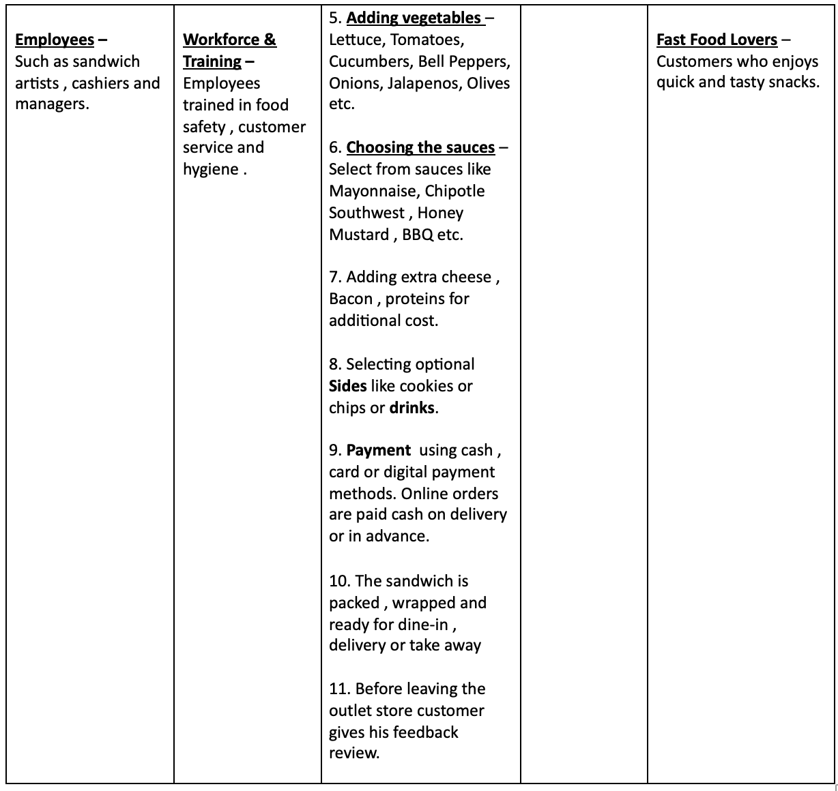
Nilkamal School of Mathematics, Applied Statistics & Analytics

Slide 8
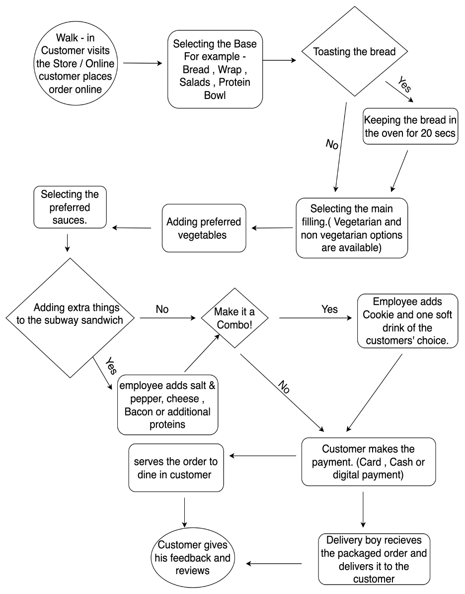
Process Map :
Nilkamal School of Mathematics, Applied Statistics & Analytics

Slide 9
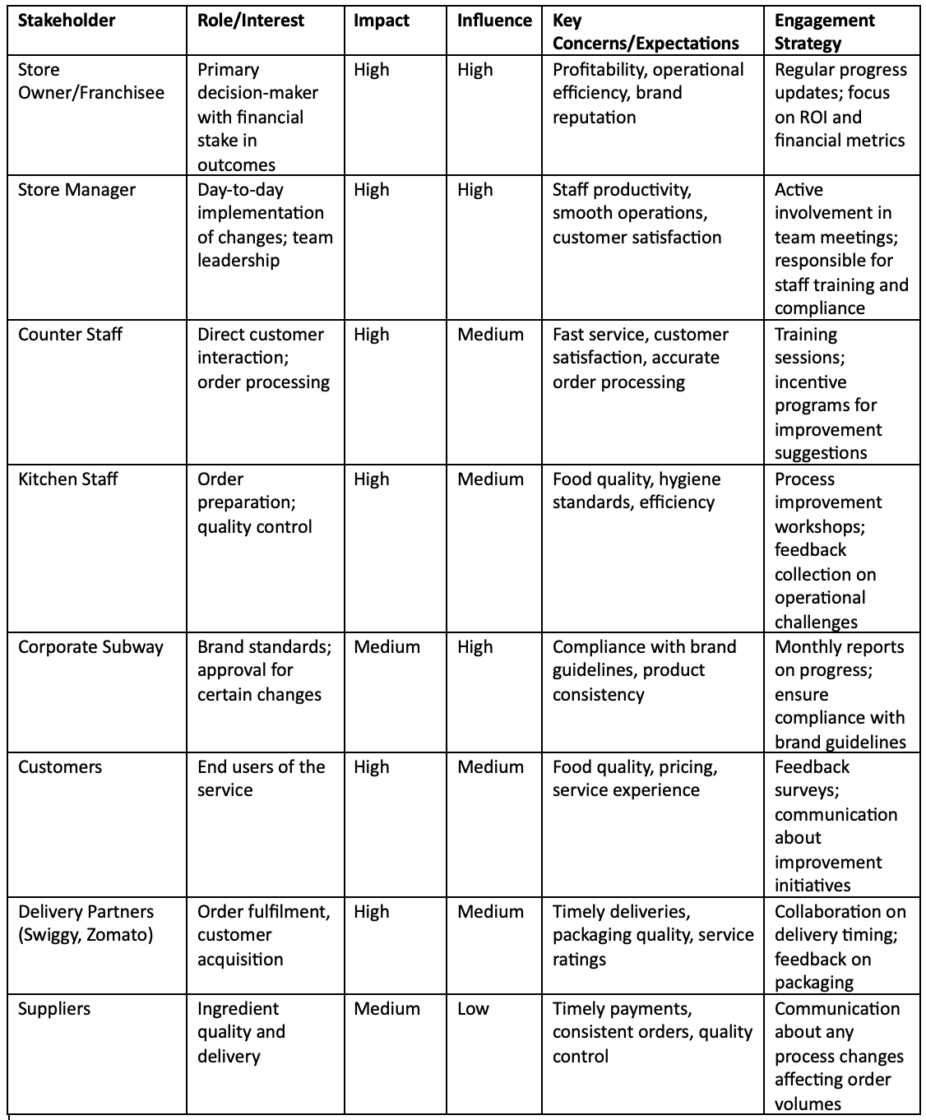
Stakeholder Analysis :
Nilkamal School of Mathematics, Applied Statistics & Analytics

Slide 10
Project Plan :
Nilkamal School of Mathematics, Applied Statistics & Analytics
PHASE | KEY ACTIVITIES | TIMELINE
Define | -Validate problem and goal statements. - Finalize project scope. - Create a SIPOC diagram. - Create Process Map - Stakeholder Analysis | December 2024 & January 2025
Measure | - Data Collection and processing - Control Charts - Pareto Charts | February 2025
Analyze | - Perform Root Cause Analysis ( 5 Why’s) - Fishbone diagram - FMEA (Failure modes and effect analysis) | March 2025
Improve | - Making a SOP and a training plan at subway | March 2025
Control | - Monitor performance | April 2025 & beyond

Slide 11
Data Collection & Preparation
Nilkamal School of Mathematics, Applied Statistics & Analytics
MEASURE PHASE
The data used for this study was collected from a Subway outlet in Atharv Pride, Vile Parle East, for two financial years: 2023-24 and 2024-25 (10 months).
Each dataset has 9 key columns:
Date – Represents the end of each month.
Total Orders – The total number of customer orders received.
Problem Orders – Orders that had issues, including late deliveries, wrong items, or complaints.
Late Delivery – Number of orders delivered after the expected time.
Dining Quality – Number of dine-in customers who reported dissatisfaction with food quality.
Staff Behaviour – Number of complaints related to staff service.
Table Cleaning – Number of complaints about unclean tables.
Wrong Order Delivered – Number of orders where the wrong items were delivered.
Miscellaneous – Other minor customer complaints or issues.

Slide 12
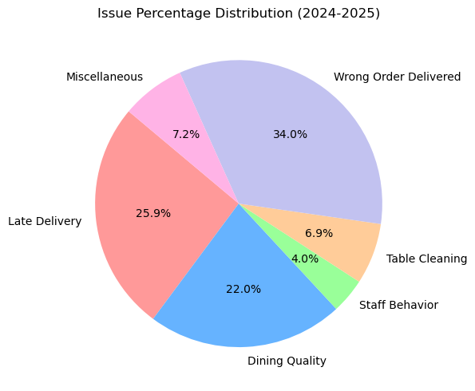
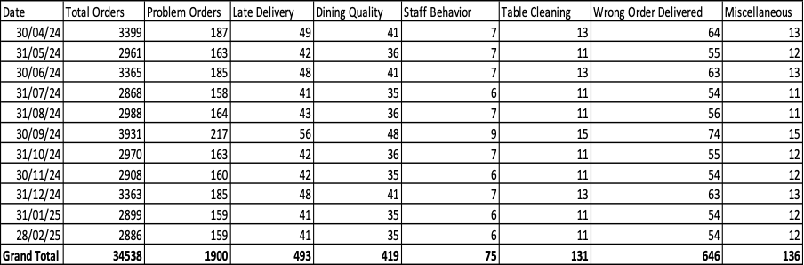
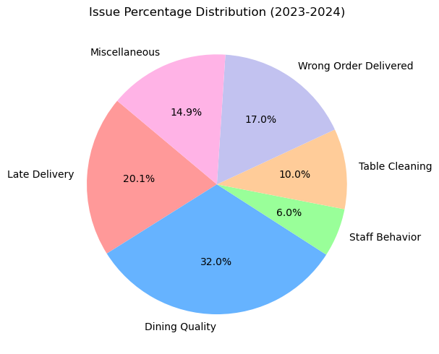
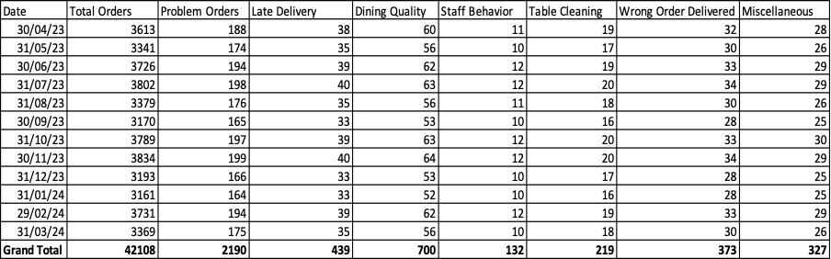
Nilkamal School of Mathematics, Applied Statistics & Analytics
For 2024 – 25 ,
For 2023 – 24 ,

Slide 13
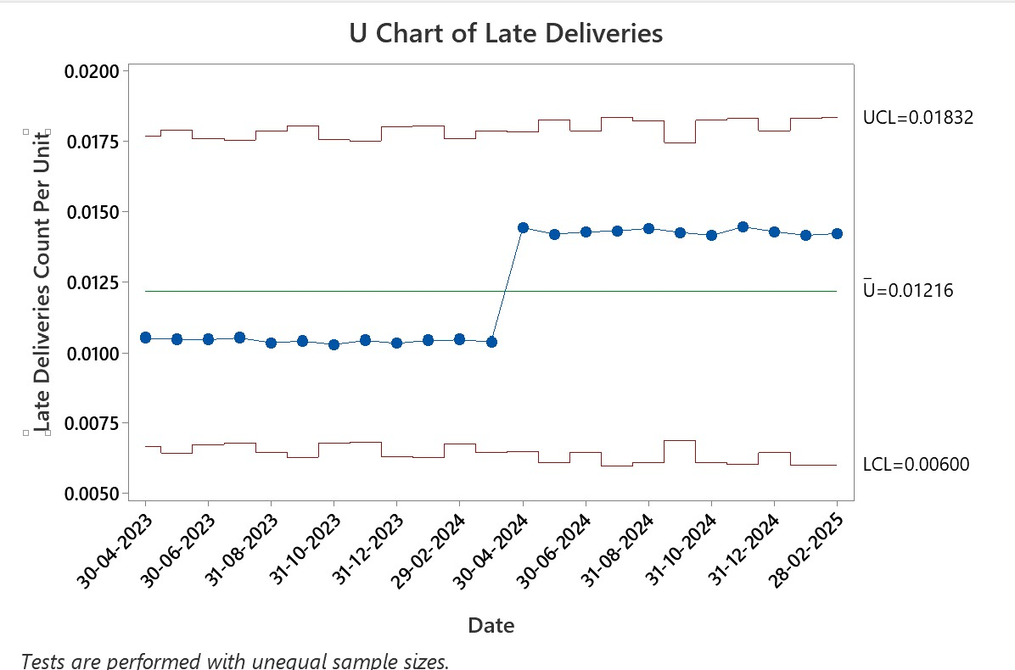
Control Chart
Nilkamal School of Mathematics, Applied Statistics & Analytics
Control charts are a statistical process control tool that is used to monitor variation and stability in processes over time
Control charts for wrong orders delivered and late deliveries in this research help detect trends, reveal inconsistencies, and ascertain whether the processes are in control.
For Late Deliveries
X-axis: Time (from Apr 2023 to Feb 2025)
Y-axis: Rate of late deliveries per order (defects per unit)
Centre Line (Ū): 0.01216 → this is the average late delivery rate
Upper Control Limit (UCL): 0.01832 → Level above which the process is out of control.
Lower Control Limit (LCL): 0.00600 → Level below which the process is out of control.
Points (blue dots) = monthly late delivery rate

Slide 14
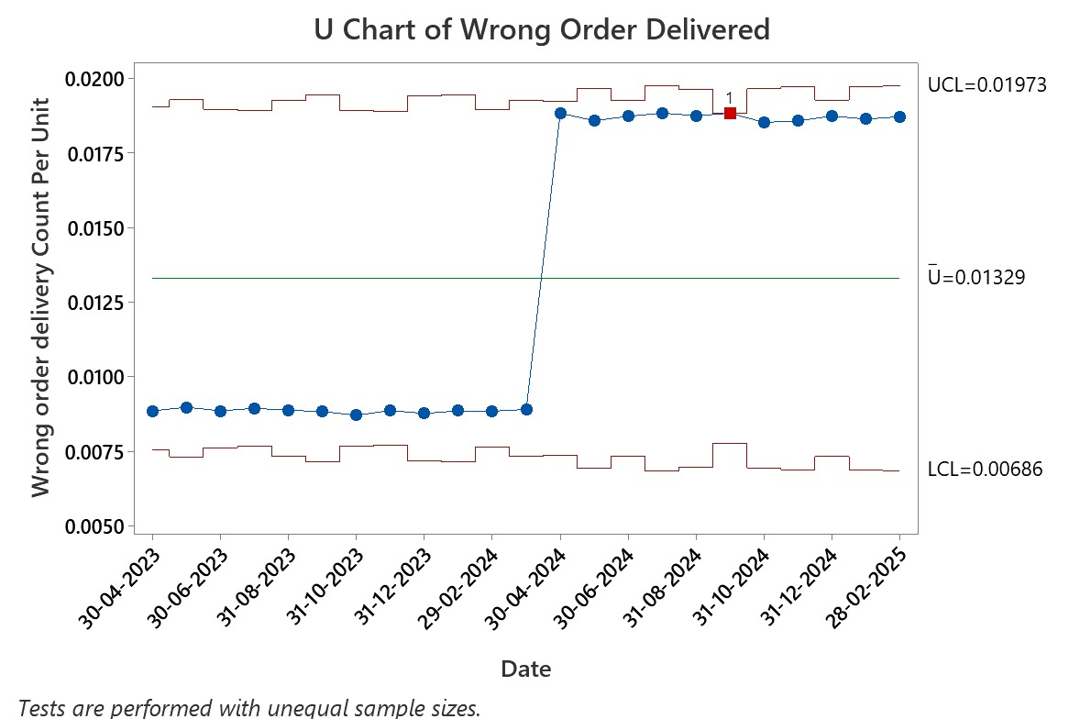
Interpretation:
Nilkamal School of Mathematics, Applied Statistics & Analytics
The process for deliveries was initially stable but not at an optimal level.
Around April 2024, a process shift occurred, leading to an increase in late deliveries.
Though still within control limits, this shift indicates a process inefficiency and not just a one-time anomaly.
Root cause analysis will be required in the Analyze Phase to identify what changed around April 2024.
For Wrong
Orders Delivered

Slide 15
Interpretation :
Nilkamal School of Mathematics, Applied Statistics & Analytics
Process performance was consistent and acceptable until early 2024.
A major spike in wrong order deliveries began in April 2024.
One point is flagged due to special cause variation, indicating a non-random event or process anomaly.
This signals an urgent need for investigation, as this issue is not just due to random fluctuation.
- The U charts reveal that while the processes were initially stable, a significant process deterioration began around April 2024 for both the issues. These trends highlight the need to investigate potential root causes in the Analyze Phase to drive targeted improvements.

Slide 16
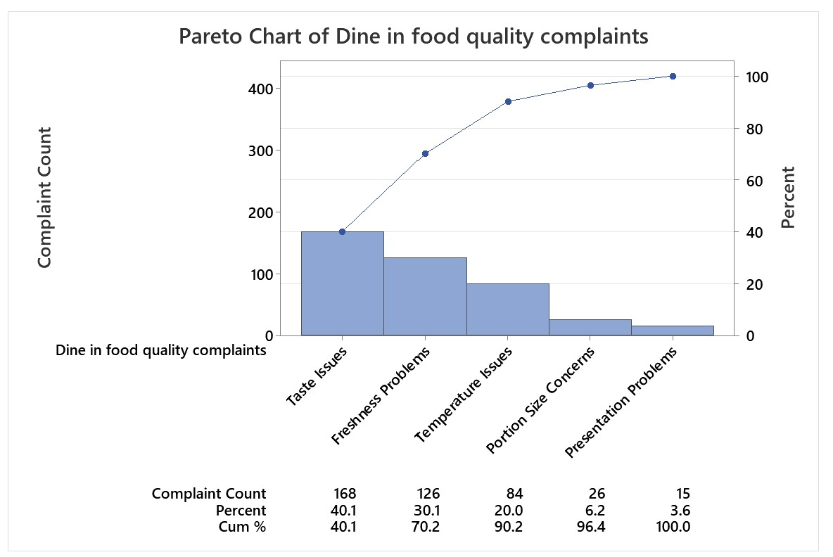
Pareto Chart
Nilkamal School of Mathematics, Applied Statistics & Analytics
A Pareto Chart is a technique that supports the 80/20 rule, illustrating how 80% of problems stem from 20% of reasons.
It is utilized to identify and rank the most significant sources of a problem in order for businesses to focus on the most impactful improvements.
Pareto charts for Dine-in quality, Wrong order delivered and Late deliveries are created in order to unveil the causes of these issues.
Dine – in Food Quality
Taste Issues (40%), Freshness Problems (30%), and Temperature Issues (20%) together contribute 90% of total food quality complaints.
This confirms that Taste, Freshness, and Temperature are the biggest problem areas, more than 80% of total complaints , aligning with the Pareto Principle. (80/20 Rule).
Portion Size and Presentation Problems have minimal impact, making them lower-priority improvement areas.

Slide 17
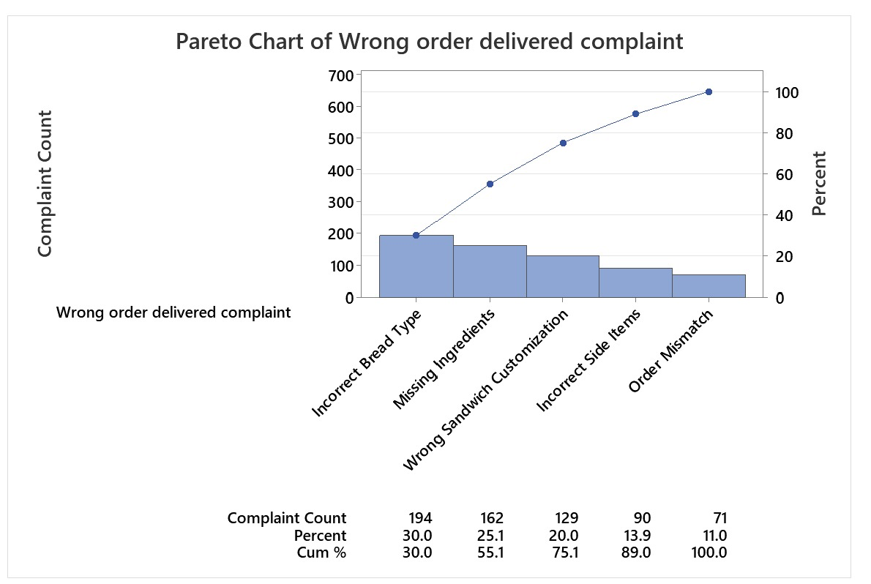
Nilkamal School of Mathematics, Applied Statistics & Analytics
Wrong Order Delivered
Incorrect Bread Type(30%) , Missing Ingredient(25%) , Wrong sandwich customization(20%) together contribute to 75% of the total wrong order delivery problem.
The highest three problems (Incorrect Bread Type, Missing Ingredients, and Wrong Customization) contribute 75% of all wrong orders. This closely follows the 80/20 principle, showing that few causes make up most of the mistakes.
Incorrect side items and Order mismatch (Digital Errors) have minimal impact making them lower priority improvement areas

Slide 18
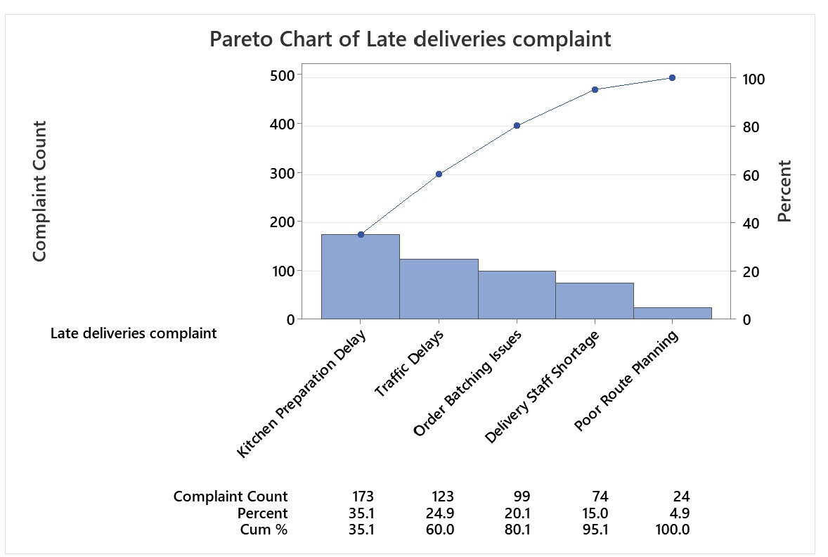
Nilkamal School of Mathematics, Applied Statistics & Analytics
Late Deliveries
Kitchen Preparation Delay(35%) , Traffic Delays(25%) , Order Batching Issues(20%) together contribute to 80% of the total Late Delivery Problems.
The highest three problems Kitchen Preparation Delay, Traffic Delays and Order Batching Issues are biggest problem areas contributing to 80% of the problems. Aligning with Pareto (80/20 Principle).
Delivery Staff Shortage and Poor Route Planning have minimal impact making them lower priority improvement areas.

Slide 19
ANALYZE PHASE
Nilkamal School of Mathematics, Applied Statistics & Analytics
Root Cause Analysis (The 5 Why’s Analysis and Fishbone Diagram)
Root Cause Analysis (RCA) is a systematic approach to identifying the root causes of a problem, and not just treating its symptoms. It helps organizations eliminate recurring problems by addressing their root causes.
In this study, we utilized 5 Whys Analysis to identify the root causes of late deliveries, wrong orders, and poor-quality food so that we could develop evidence-based improvement solutions.
A. Dine - In Food Quality Complaints (22%) → Target (11%)
1. Why are customers complaining about freshness?
Because some ingredients taste stale or spoiled.
2. Why are ingredients stale in taste?
Since they were not properly stored or consumed after their expiration date.
3. Why are ingredients stored inappropriately?
Because of different refrigeration temperatures and not always applying FIFO.
4. Why is the refrigeration temperature different?
Because of poor care, and constant opening of the refrigerators.

Slide 20
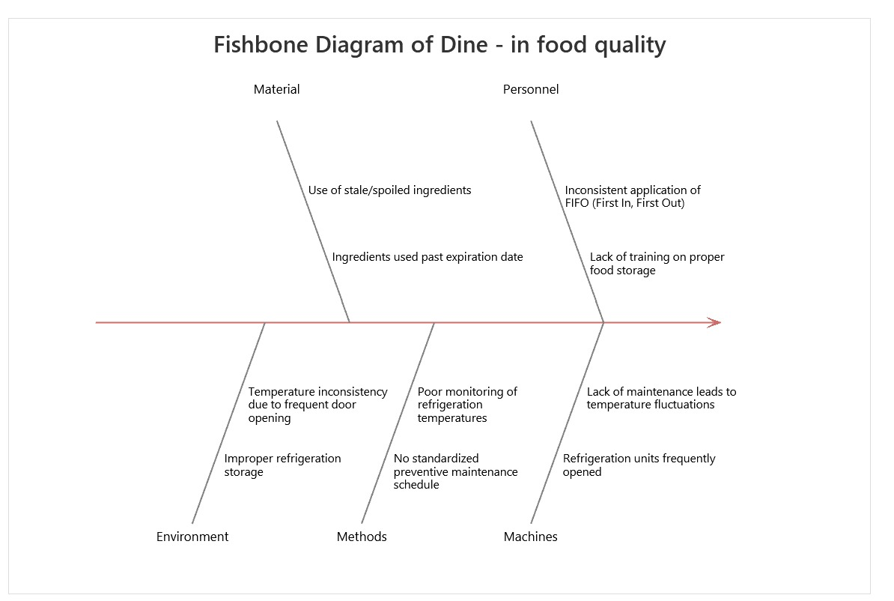
Nilkamal School of Mathematics, Applied Statistics & Analytics
5. Why does maintenance fluctuate ?
As there is no standardized preventive maintenance schedule for refrigeration equipment.
Root Cause: Poor storage procedures and lack of equipment maintenance.

Slide 21
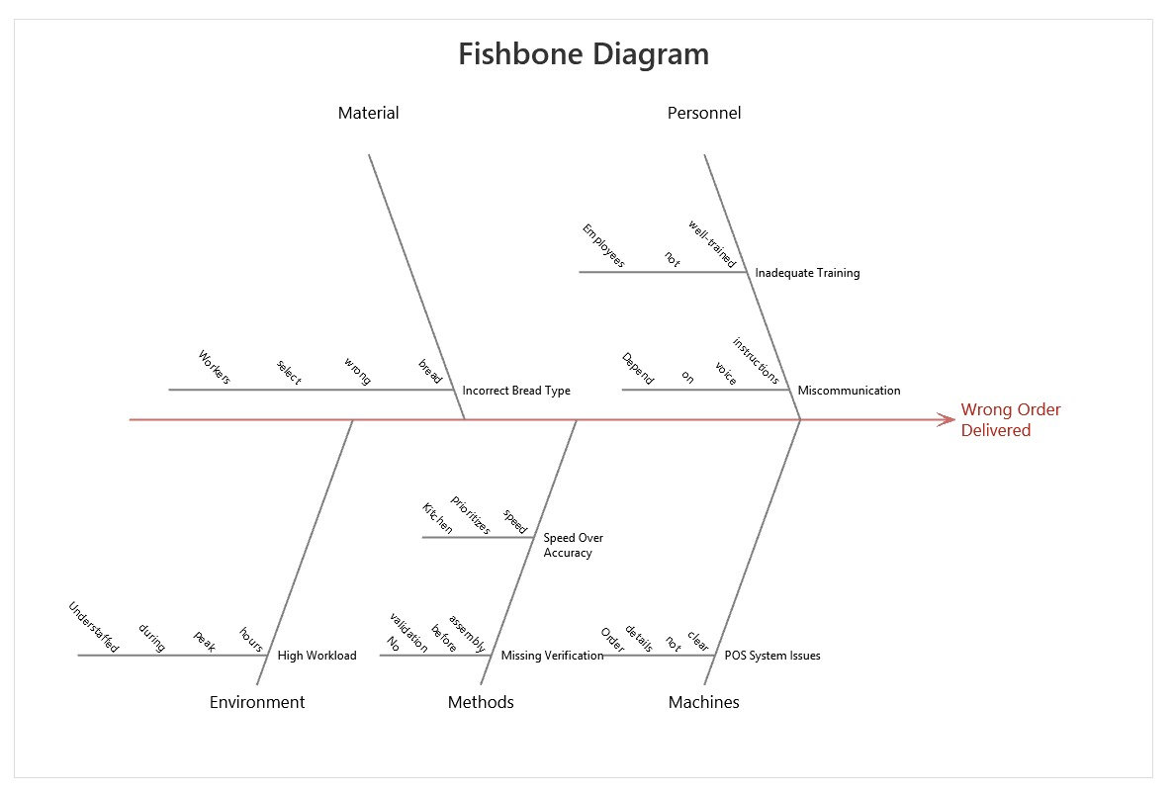
Nilkamal School of Mathematics, Applied Statistics & Analytics
B. Wrong Order Delivered Complaints (34%) → Target(17%)
1. Why are the customers receiving the incorrect bread?
Since the workers use the wrong kind of bread.
2. Why would they select the wrong bread?
Because they don't comprehend the order or depend on voice instructions.
3. Why do they get orders wrong?
Because there is no validation step before sandwich assembly.
4. Why is there no verification process?
Because the kitchen workflow favors speed over precision.
5. Why is speed prioritized over accuracy ?
Because there are no definite SOPs (Standard Operating Procedures) that necessitate a double-check system.
Root Cause: Inadequate employee training and order verification.

Slide 22
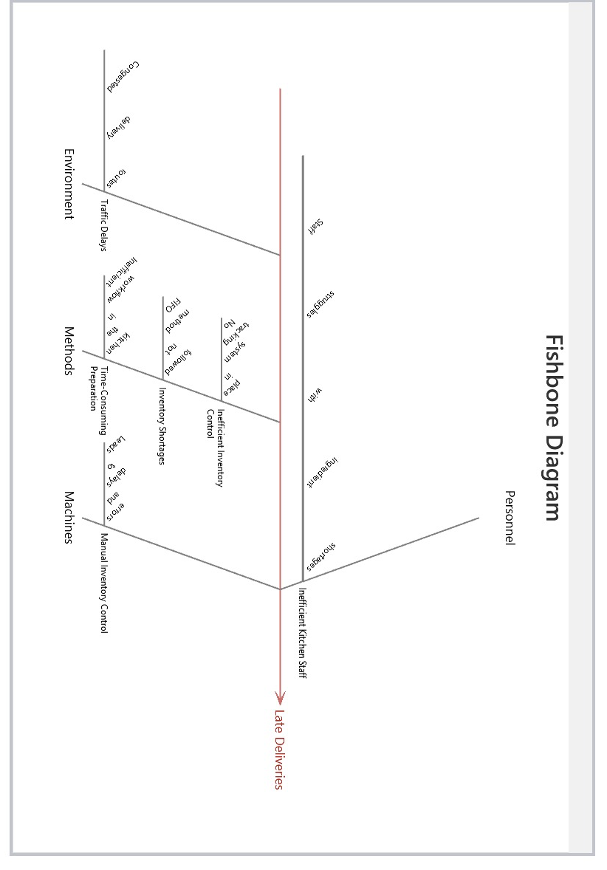
Nilkamal School of Mathematics, Applied Statistics & Analytics
C. Late Deliveries Complaints ( 25.9 %) → Target ( 13%)
Why are deliveries late?
Because preparing food is too time-consuming.
2. Why is preparation taking so long?
Since the kitchen staff are plagued by ingredient shortages and inefficient workflow.
3. Why do ingredient shortages occur?
Because the inventory is not replenished in the first place, and the FIFO method is not practiced.
4. Why is inventory restocking inefficient?
As there is no organized inventory control system.
5. Why is there no tracking system?
Because inventory control is manual, there are delays and errors.
Root Cause: Ineffective kitchen workflow and absence of inventory management.

Slide 23
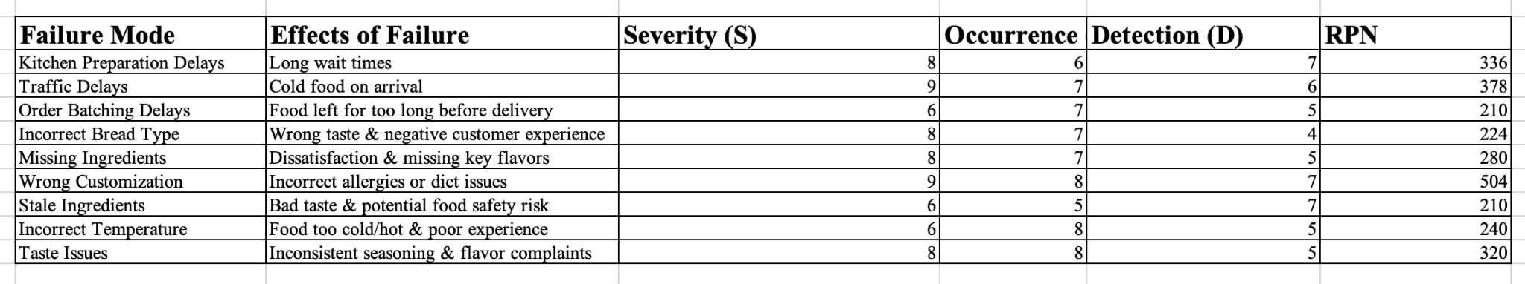
FAILURE MODES AND EFFECT ANALYSIS (FMEA) :
Nilkamal School of Mathematics, Applied Statistics & Analytics
Carefully reviewed potential areas of failure and assigned Severity, Occurrence, and Detection ratings based on logical assumptions, industry research, and trends.
From these ratings, calculated the Risk Priority Number (RPN) to prioritize important problems.
A higher RNP indicates that those issues must be prioritized for fixing the problem.
Risk Priority Number (RPN) = Severity(S) X Occurrence(O) X Detection(D)
Outcome :
1. Since Wrong Customization has the highest RNP score ie. 504 we can say that it is the most critical failure mode which requires a double check process before customization.
2. Late Deliveries are primarily caused by Traffic delays with RNP score of 378 which means that route optimization and GPS tracking is required.
3. Food Quality Complaints rise from Taste issues with RNP of 320 and missing ingredients with a RNP of 280 which requires standardization of recipes and better inventory.

Slide 24
Nilkamal School of Mathematics, Applied Statistics & Analytics
IMPROVE PHASE
Standard Operating Procedure (SOP) :
Location : Subway Atharv Pride Branch , Vile Parle East
Prepared by : Kushal Dutia
Date : 26 / 03 / 2025
Purpose :
This SOP aims to standardize critical processes at Subway Atharv Pride to improve service efficiency, minimize errors, and increase customer satisfaction.
The key areas of focus include:
Decreasing late deliveries (from 25.9% to 13% by Q3 2025)
Decreasing dine-in food quality grievances (from 22% to 11%)
Decreasing erroneous delivery orders (34% to 17%)

Slide 25
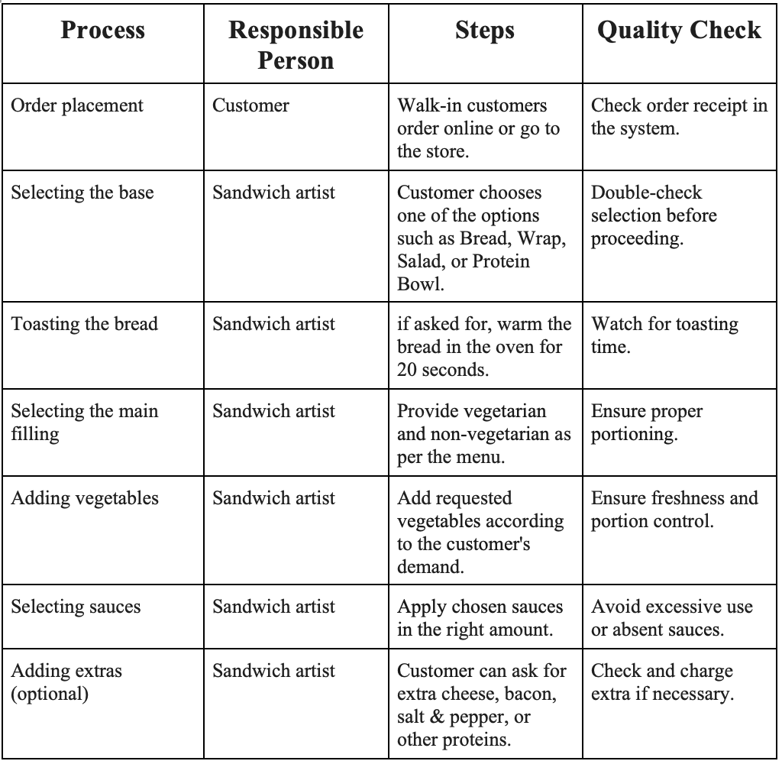
Nilkamal School of Mathematics, Applied Statistics & Analytics

Slide 26
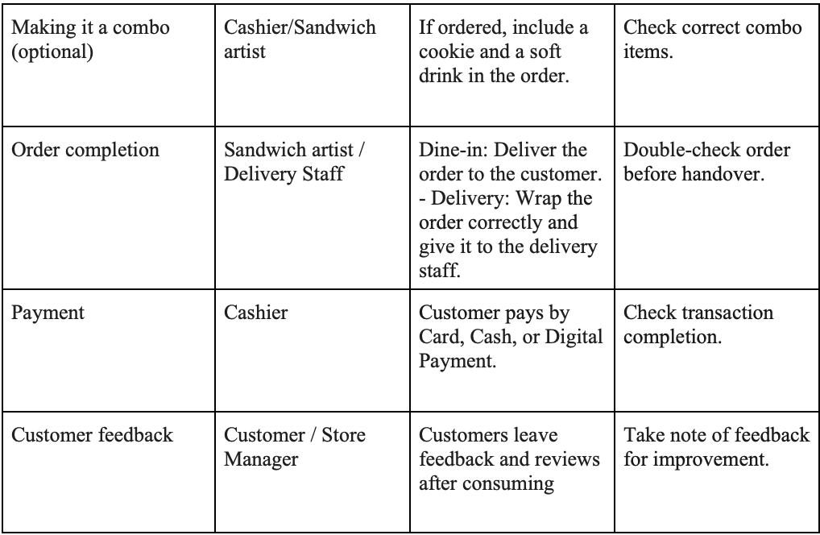
Nilkamal School of Mathematics, Applied Statistics & Analytics

Slide 27
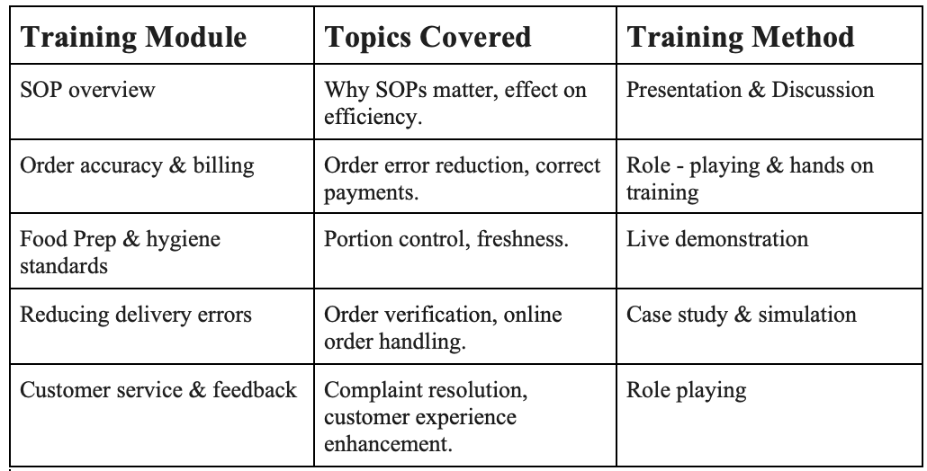
Training plan :
Nilkamal School of Mathematics, Applied Statistics & Analytics

Slide 28
CONTROL PHASE
Nilkamal School of Mathematics, Applied Statistics & Analytics
During the Control Phase, we will concentrate on maintaining and tracking the gains accrued in the Improve Phase to guarantee long-term success.
KPIs like late delivery rates, Wrong order percentages, and food quality complaints will be monitored regularly through control charts and process audits.
Measures like Standard Operating Procedures (SOPs) mechanisms will be instituted to avoid repeating errors.
Gathering customer feedback and employee suggestions to detect any deviations and take corrective measures if necessary
Monthly reviews will guarantee efficiency and guarantee that the desired process improvements are maintained over time.

Slide 29
Conclusion :
Nilkamal School of Mathematics, Applied Statistics & Analytics
This project was designed to enhance operational effectiveness within the restaurant by minimizing late deliveries, wrong order deliveries, and dine-in food quality problems through the application of the Lean Six Sigma DMAIC approach.
The most important deliverable of this project is a systematic process to improve customer satisfaction, decrease errors, and improve service efficiency.
Through the systematic elimination of inefficiencies and reinforcement of best practices, we anticipate achieving our objective of decreasing late deliveries, wrong orders, and food quality complaints by 50% or more by Q3 2025.
Overall, the project proves the capability of Lean Six Sigma tools to bring quantifiable improvement in a service industry and establish a culture of ongoing process improvement.

Slide 30
Limitations :
Nilkamal School of Mathematics, Applied Statistics & Analytics
Data Availability & Accuracy: The study was based on the available data, which may not have captured all the real variations in activities.
Implementation Challenges: Although SOPs measures were intended to reduce errors, uniform application by all employees is promoted by training and behavioral modification, and effectiveness can be hindered by resistance to change.
External Factors: Some of the problems, such as delayed deliveries, may be due to external factors such as traffic, weather, or third-party delivery partners that the restaurant cannot control.
Restricted Root Cause Analysis Scope: The 5 Whys and FMEA tools pointed out major failure areas, but additional statistical analysis (e.g., DOE - Design of Experiments) would tell us even more about how we could further optimize the process.

Slide 31
Future Work :
Nilkamal School of Mathematics, Applied Statistics & Analytics
Full Control Phase Implementation: Implement systematic surveillance through a system of control charts, process audits, and ongoing observation of data for ongoing improvement.
Real-Time Order & Delivery Tracking: Use RFID or GPS-based tracking to track order flow and delivery efficiency, minimizing uncertainty over delivery timelines.
AI & Predictive Analytics for Demand Forecasting: Utilize data-driven AI solutions to predict peak hours, ingredient needs, and delivery wait times, optimizing operational efficiency.
Customer Feedback Integration: Ensure there is an organized feedback mechanism (survey, sentiment, VOC programs) to measure customer satisfaction directly contributing to process improvements.

Slide 32
Thank You
Nilkamal School of Mathematics, Applied Statistics & Analytics
Semester Ⅵ Project
Quality Management
Mentored by:
Prof. Sunil Shirvaiker
A016 - Kushal Dutia

